Slide 1
Day 07
More Denavit-Hartenberg Examples

Slide 2
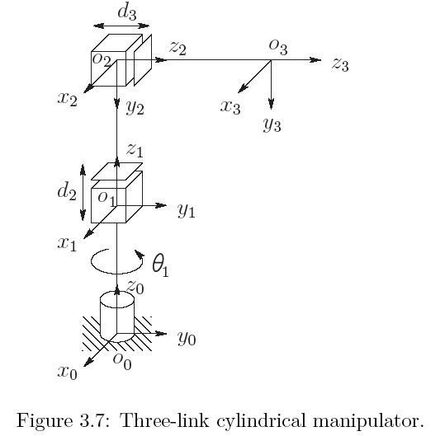
Step 5: Find the DH parameters
Link | a_{i} | α_{i} | d_{i} | θ_{i}
1 | 0 | 0 | d₁ | θ₁*
2 | 0 | -90 | d₂* | 0
3 | 0 | 0 | d₃* | 0
* joint variable

Slide 3
Step 6: Compute the transformation
once the DH parameters are known, it is easy to construct the overall transformation
Link | a_{i} | α_{i} | d_{i} | θ_{i}
1 | 0 | 0 | d₁ | θ₁*
2 | 0 | -90 | d₂* | 0
3 | 0 | 0 | d₃* | 0
* joint variable

Slide 4
Step 6: Compute the transformation
Link | a_{i} | α_{i} | d_{i} | θ_{i}
1 | 0 | 0 | d₁ | θ₁*
2 | 0 | -90 | d₂* | 0
3 | 0 | 0 | d₃* | 0
* joint variable

Slide 5
Step 6: Compute the transformation
Link | a_{i} | α_{i} | d_{i} | θ_{i}
1 | 0 | 0 | d₁ | θ₁*
2 | 0 | -90 | d₂* | 0
3 | 0 | 0 | d₃* | 0
* joint variable

Slide 6
Step 6: Compute the transformation

Slide 7
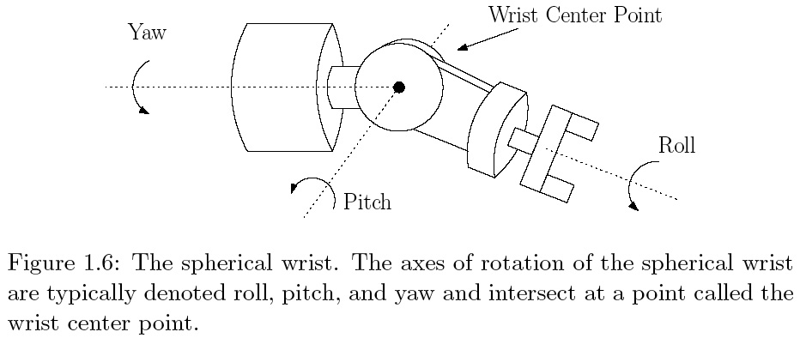
Spherical Wrist

Slide 8
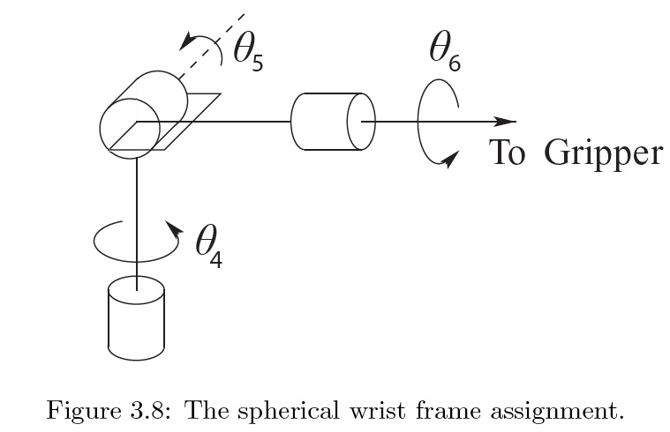
Spherical Wrist

Slide 9
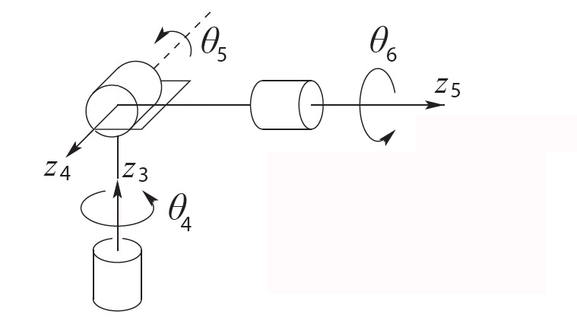
Spherical Wrist: Step 1

Slide 10
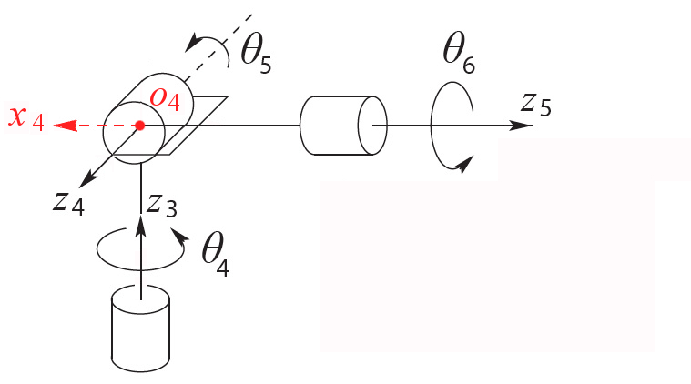
Spherical Wrist: Step 2

Slide 11
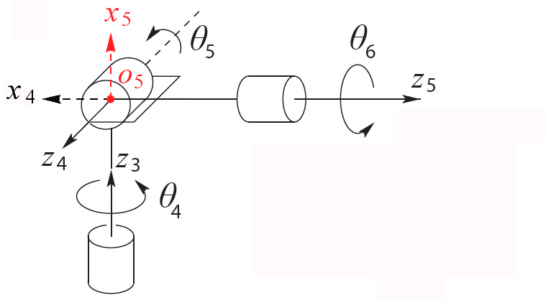
Spherical Wrist: Step 2

Slide 12
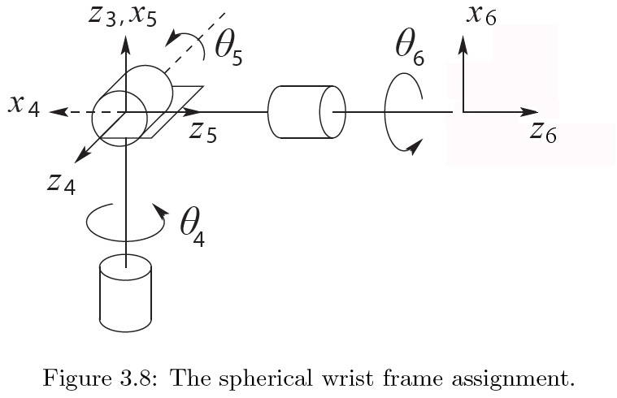
Spherical Wrist: Step 4

Slide 13
Step 5: DH Parameters
Link | a_{i} | α_{i} | d_{i} | θ_{i}
4 | 0 | -90 | 0 | θ₄*
5 | 0 | 90 | 0 | θ₅*
6 | 0 | 0 | d₆ | θ₆*
* joint variable

Slide 14
Step 6: Compute the transformation

Slide 15
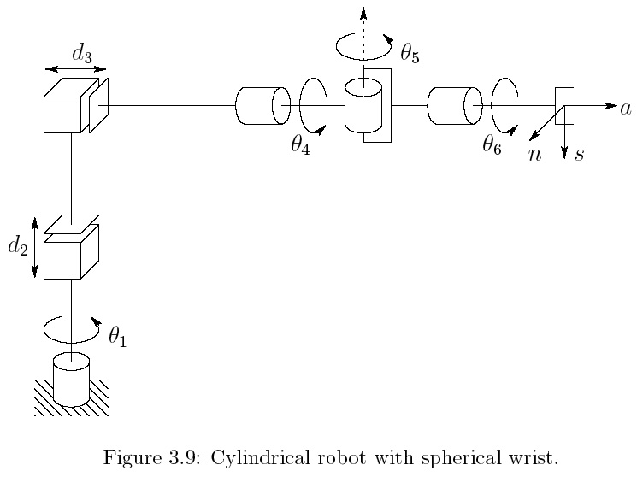
RPP + Spherical Wrist

Slide 16
RPP + Spherical Wrist

Slide 17
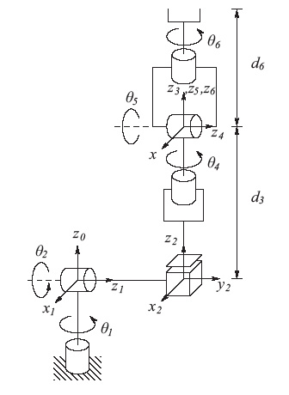
Stanford Manipulator + Spherical Wrist
Link | a_{i} | α_{i} | d_{i} | θ_{i}
1 | 0 | -90 | 0 | θ₁*
2 | 0 | 90 | d₂ | θ₂*
3 | 0 | 0 | d₃* | 0
4 | 0 | -90 | 0 | θ₄*
5 | 0 | 90 | 0 | θ₅*
6 | 0 | 0 | d₆ | θ₆*
* joint variable

Slide 18
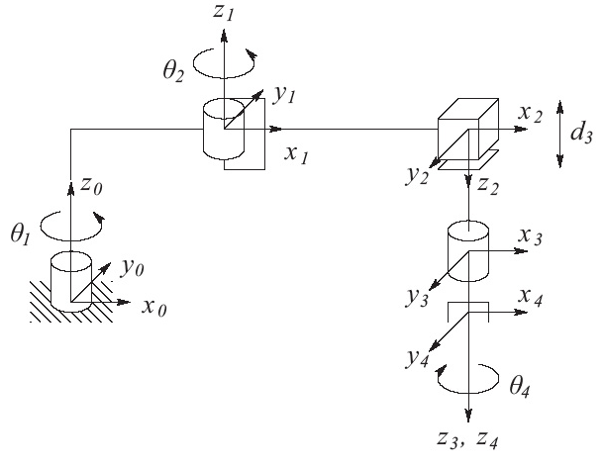
SCARA + 1DOF Wrist
Link | a_{i} | α_{i} | d_{i} | θ_{i}
1 | a₁ | 0 | d₁ | θ₁*
2 | a₂ | 180 | 0 | θ₂*
3 | 0 | 0 | d₃* | 0
4 | 0 | 0 | d₄ | θ₄*
* joint variable

